Slide 1
汇编语言
第九讲 MIPS汇编（二）

Slide 2
第九讲 MIPS汇编（二）
一、MIPS汇编交叉编译调试
二、浮点指令
三、MIPS O32 ABI简介
四、C程序对照

Slide 3
MIPS汇编交叉编译运行环境
在X86平台上采用交叉编译（cross-compile）
在X86平台上采用模拟器（qemu）运行
  运行静态连接程序
在X86平台采用交叉调试（cross-gdb）
Ubuntu交叉编译运行环境的安装：
$ sudo apt-get install gcc-mipsel-linux-gnu （安装mips交叉编译环境）
$ sudo apt-get install qemu-user-static （安装模拟运行环境）
$ sudo apt-get install gdb-multiarch （安装交叉调试环境）

Slide 4
MIPS汇编交叉编译运行
$ mipsel-linux-gnu-as -o hello.o hello.S
$ mipsel-linux-gnu-ld -o hello hello.o
$ qemu-mipsel-static hello
hello world

Slide 5
MIPS汇编交叉编译运行
上面的方法可能不管用

Slide 6
MIPS汇编交叉编译运行环境
Ubuntu交叉编译环境的安装：
下载 gcc-4.3-ls232.tar.gz
wget http://ftp.loongnix.org/toolchain/gcc/release/gcc-4.3-ls232.tar.gz 进入 gcc-4.3-ls232.tar.gz 所在文件夹
运行： sudo tar -zxvf gcc-4.3-ls232.tar.gz -C /
进入：/opt/gcc-4.3-ls232/bin
sudo apt-get install lib32ncurses5-dev
sudo apt-get install zlib1g:i386
再进入 gcc-4.3-ls232.tar.gz 所在文件夹
echo "export PATH=/opt/gcc-4.3-ls232/bin:$PATH" >> ~/.bashrc
source ~/.bashrc

Slide 7
MIPS汇编交叉编译运行
$ mipsel-linux-as -o hello.o hello.S
$ mipsel-linux-ld -o hello hello.o
$ qemu-mipsel-static hello
hello world

Slide 8
MIPS编译-反汇编
mipsel-linux-gcc test.c -S -o test.S

Slide 9
MIPS汇编交叉调试
<1>Ubuntu下打开一个终端：
$ qemu-mipsel-static -g 1234 hello
<2>然后打开另一个终端：
$ gdb-multiarch hello
……
Reading symbols from hello...(no debugging symbols found)...done.
(gdb) target remote:1234
Remote debugging using :1234
0x004000f0 in _ftext ()
(gdb) disassemble
Dump of assembler code for function _ftext:
=> 0x004000f0 <+0>: li v0,4004
……
(gdb) si
0x004000f4 in _ftext ()
(gdb) info registers
……

Slide 10
使用示范
#hello.S
.section .data
output: .ascii "hello world\n"
.section .text
.globl __start
__start:
addiu $v0, $0, 4004
addiu $a0, $0, 1
la $a1, output
addiu $a2, $0, 12
syscall
addiu $v0, $0, 4001
addiu $a0, $0, 0
syscall

Slide 11
输出字符串0123456789
#loop.S
.section .data
bytevar:
.rept 10
.byte 0x0
.endr
.section .text
.globl __start
__start:
lui $t0, %hi(bytevar)
addiu $t0, $t0, %lo(bytevar)
addu $a1, $0, $t0
addiu $t1, $0, 0x30
L1:
sb $t1, 0($t0)
addiu $t1, $t1, 1
sltiu $t3, $t1, 0x3a
addiu $t0, $t0, 1
bgtz $t3, L1
#output
addiu $v0, $0, 4004
addiu $a0, $0, 1
# la $a1, bytevar
addiu $a2, $0, 10
syscall
#exit
addiu $v0, $0, 4001
addiu $a0, $0, 0
syscall

Slide 12
X86 vs. MIPS
X86
MIPS
_start:
mov $bytevar, %ebx
mov $0x30, %al
mov $10, %ecx
L1:
movb %al, (%ebx)
inc %ebx
inc %al
loop L1
__start:
lui $t0, %hi(bytevar)
addiu $t0, $t0, %lo(bytevar)
addu $a1, $0, $t0
addiu $t1, $0, 0x30
L1:
sb $t1, 0($t0)
addiu $t1, $t1, 1
sltiu $t3, $t1, 0x3a
addiu $t0, $t0, 1
bgtz $t3, L1

Slide 13
Delay slot
004000f0 <_ftext>:
4000f0: 3c080041 lui t0,0x41
4000f4: 25080130 addiu t0,t0,304
4000f8: 00082821 addu a1,zero,t0
4000fc: 24090030 li t1,48
00400100 <L1>:
400100: a1090000 sb t1,0(t0)
400104: 25290001 addiu t1,t1,1
400108: 2d2b003a sltiu t3,t1,58
40010c: 1d60fffc bgtz t3,400100 <L1>
400110: 25080001 addiu t0,t0,1
400114: 24020fa4 li v0,4004
400118: 24040001 li a0,1
40011c: 2406000a li a2,10
400120: 0000000c syscall
400124: 24020fa1 li v0,4001
400128: 24040000 li a0,0
40012c: 0000000c syscall

Slide 14
第九讲 MIPS汇编（二）
一、MIPS汇编交叉编译调试
二、浮点指令
三、MIPS O32 ABI简介
四、C程序对照

Slide 15
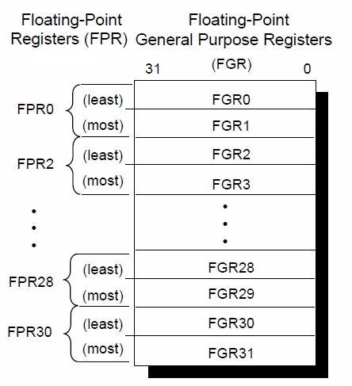
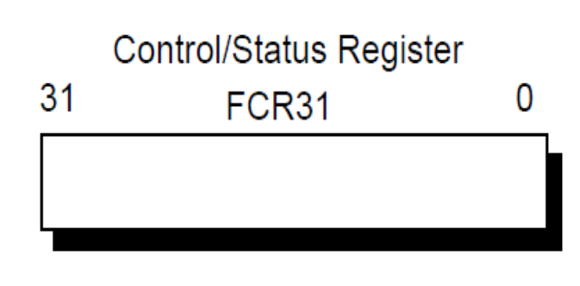
浮点运行环境（MIPS1）
ANSI/IEEE Standard 754–1985
IEEE Standard for Binary
Floating-Point Arithmetic

Slide 16
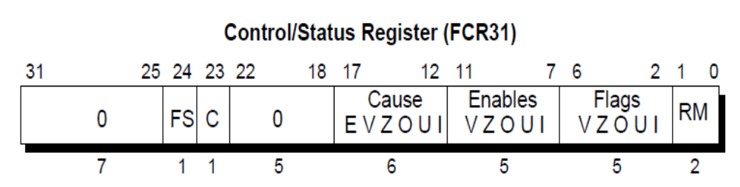
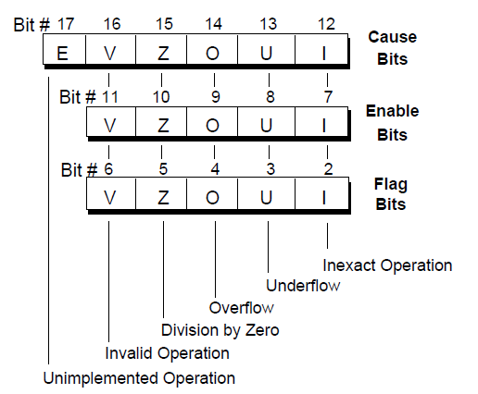
FCR31
C：Condition bit.The C bit is set to 1 if the condition is true and is cleared to 0 if the condition is false.
最近
FS：When the FS bit is set, denormalized results are flushed to 0 instead of
causing an unimplemented operation exception
累计
RM：Rounding mode bits.

Slide 17
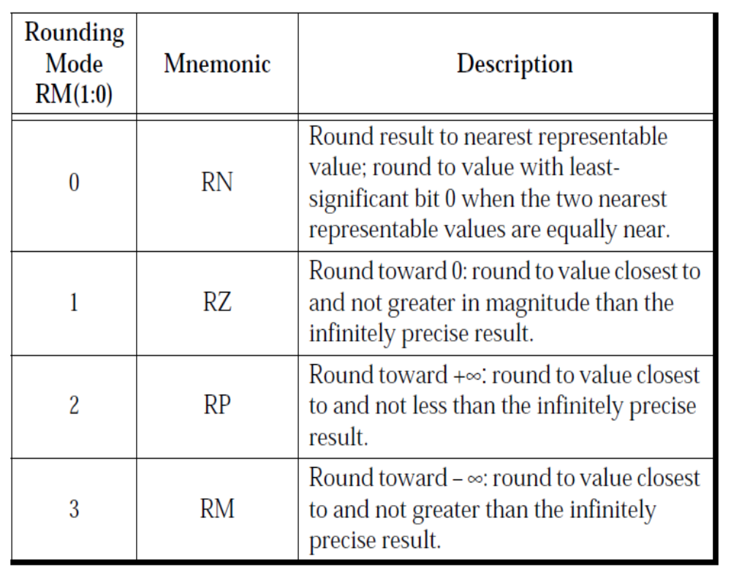
Rounding Mode

Slide 18
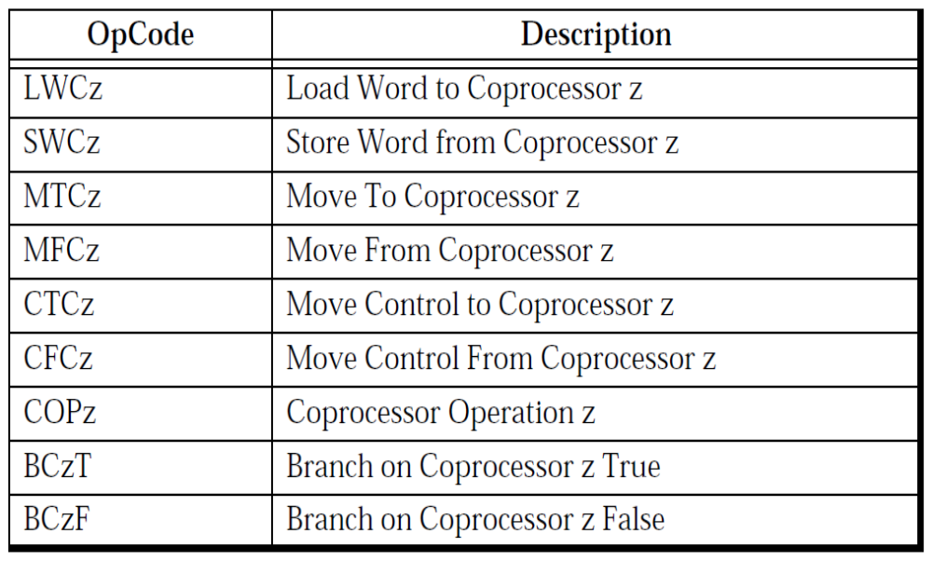
Coprocessor Instruction

Slide 19
浮点—Coprocessor 1
LWC1 & SWC1 ：浮点Load & Store
MTC1 & MFC1：通用寄存器与浮点寄存器交换数据
CTC1 & CFC1：操作浮点控制状态寄存器
BC1F & BC1T：浮点分支指令
COP1：浮点ALU操作指令

Slide 20
LWC1 & SWC1
lwc1 rt, offset(base)
swc1 rt, offset(base)
((offset₁₅)¹⁶||offset_{15..0}) + GPR[base]
((offset₁₅)¹⁶||offset_{15..0}) + GPR[base]
vAddr
vAddr
AddressTranslation
AddressTranslation
pAddr_{31..0}
pAddr_{31..0}
LoadMemory
StoreMemory
L3
L2
L1
L0
pAddr_{31..2}
S3
S2
S1
S0
3
0
3
0
FPR[rt]
L3
L2
L1
L0
S3
S2
S1
S0
FPR[rt]
31
0
31
0

Slide 21
LWC1 & SWC1
lwc1 $f2, 4($s0)
swc1 $f4, -4($t0)

Slide 22
MFC1 & MTC1
mfc1 rt, rd rt: GPR, rd: FPR
mtc1 rt, rd
指令 | 语义 | 例外
mfc1 $t0, $f4 | GPR[t0] = FPR[f4] | Coprocessor unusable
mtc1 $t0, $f2 | FPR[f2] = GPR[t0] | Coprocessor unusable

Slide 23
CFC1 & CTC1
cfc1 rt, rd rt: GPR, rd: FCR
ctc1 rt, rd
指令 | 语义 | 例外
cfc1 $t0, $31 | GPR[t0] = FCR[31] | Coprocessor unusable
ctc1 $t0, $31 | FCR[31] = GPR[t0] | Coprocessor unusable

Slide 24
BC1T & BC1F
指令 | 语义 | 例外
bc1t lable | If( COC[1] ) PC = lable (lable = [PC+4] + (offset₁₅)¹⁴||offset||0²) | Coprocessor unusable
bc1f lable | If( not COC[1] ) PC = lable (lable = [PC+4] + (offset₁₅)¹⁴||offset||0²) | Coprocessor unusable

Slide 25
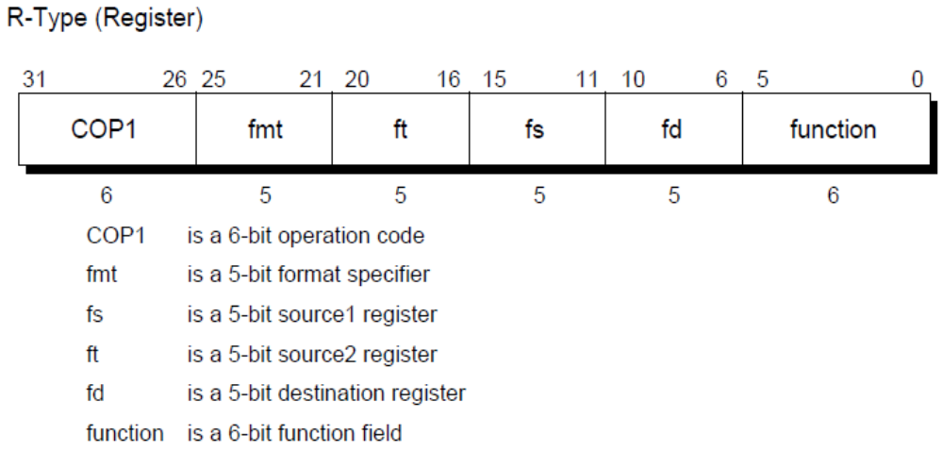
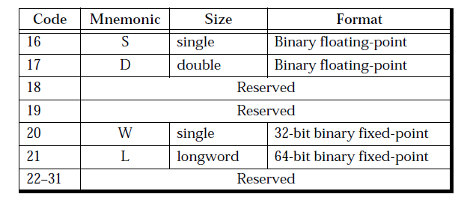
COP1

Slide 26
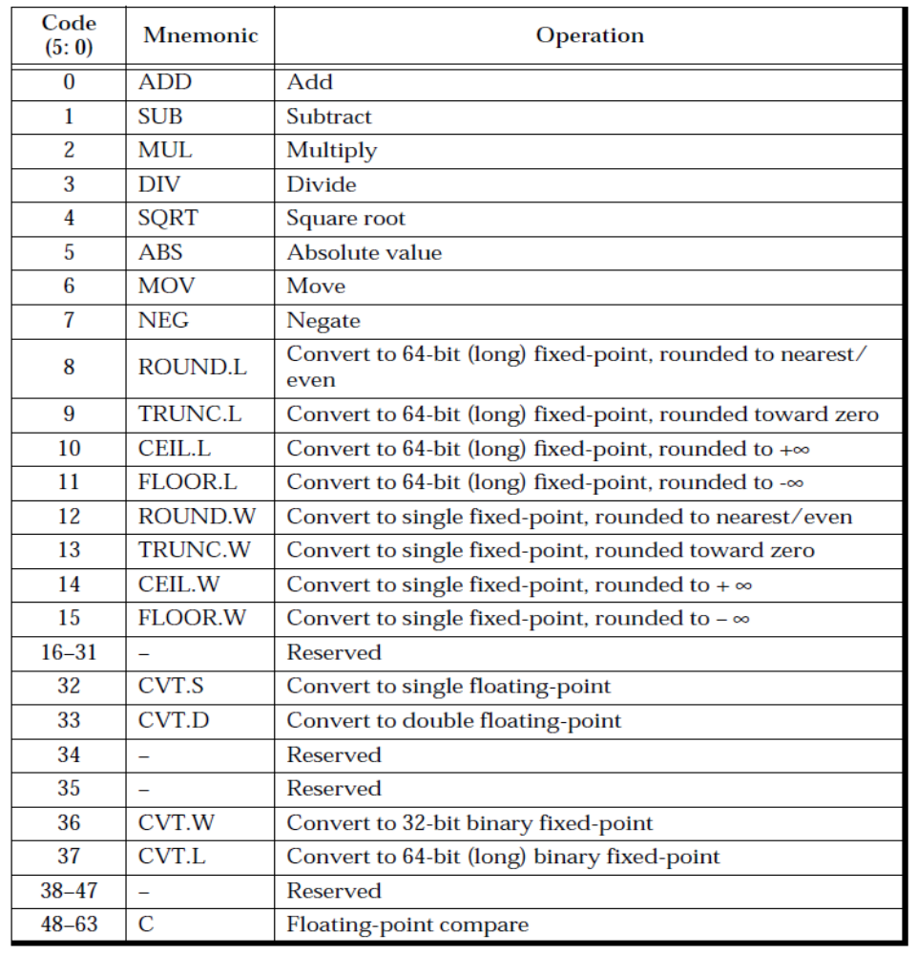
浮点ALU指令

Slide 27
算术运算
指令格式 | AT&T汇编 | 语义
abs.fmt fd, fs | abs.s $f2, $f4 abs.d $f2, $f4 | FPR(f2) = |FPR(f4)|
add.fmt fd, fs, ft | add.s $f2, $f4, $f6 add.d $f2, $f4, $f6 | FPR(f2)=FPR(f4)+FPR(f6)
sub.fmt fd, fs, ft
mul.fmt fd, fs, ft
div.fmt fd, fs, ft
sqrt.fmt fd, fs
neg.fmt fd, fs

Slide 28
取整
指令格式 | AT&T汇编 | 语义
ceil.l.fmt fd, fs | ceil.l.s $f2, $f4 ceil.l.d $f2, $f4 | FPR(f2) <-FPR(f4) Ceil to long fix-point，round->∞
ceil.w.fmt fd, fs | ceil.w.s $f2, $f4 ceil.w.d $f2, $f4 | FPR(f2) <-FPR(f4) Ceil to single fix-point, round->∞
trunc.l.fmt fd, fs |  | trunc to long fix-point， round->0
trunc.w.fmt fd, fs |  | trunc to single fix-point， round->0
floor.l.fmt fd, fs |  | floor to long fix-point， round->-∞
floor.w.fmt fd, fs |  | floor to single fix-point， round->-∞
round.l.fmt fd, fs |  | round to long fix-point，nearest(even)
round.w.fmt fd, fs |  | round to single fix-point，nearest(even)

Slide 29
格式转换
指令格式 | AT&T汇编 | 语义
cvt.d.fmt fd, fs | cvt.d.s $f2, $f4 cvt.d.w $f2, $f4 cvt.d.l $f2, $f4 | Single float->double float Single fix->double float Long fix ->double float
cvt.s.fmt fd, fs |  | double float->single float Single fix->single float Long fix ->single float
cvt.l.fmt fd, fs |  | Single float->long fix Double float -> long fix Single fix-> long fix
cvt.w.fmt fd, fs |  | Single float->single fix Double float -> single fix Long fix-> single fix

Slide 30
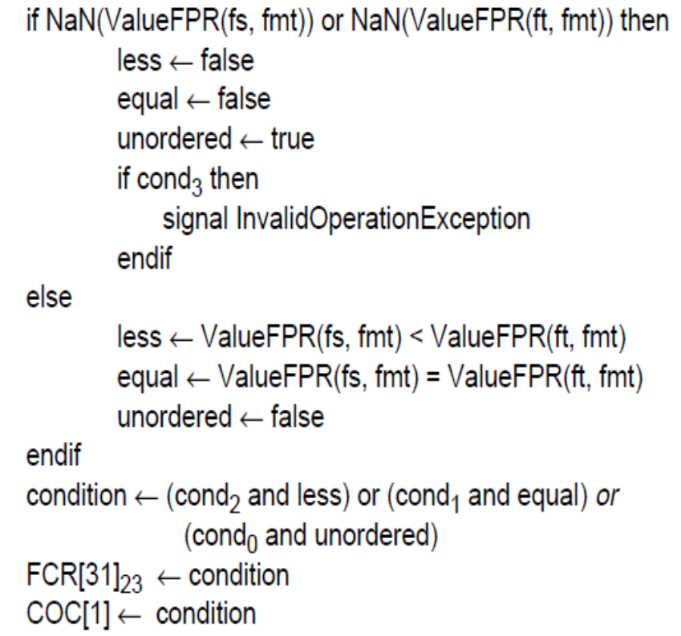
浮点比较
指令格式 | AT&T汇编 | 语义
c.cond.fmt fs, ft | c.lt.s $f2, $f4 c.eq.d $f2, $f4 c.un.s $f2, $f4 ……
cond[3..0]: [signal, less, equal, unordered]
cond: lt, eq, un, le, ult, ueq, ule

Slide 31
浮点指令示例
lwc1 $f2,16($fp) #x
lwc1 $f0,20($fp) #y
c.lt.s $f0,$f2 #y < x
nop
bc1f $L7 #false
nop
lwc1 $f0,16($fp)
swc1 $f0,4($fp)
b $L4
nop
$L7:
lwc1 $f0,20($fp)
swc1 $f0,4($fp)
$L4:
if(x > y) z = x;
else z = y;

Slide 32
第九讲 MIPS汇编（二）
一、MIPS汇编交叉编译调试
二、浮点指令
三、MIPS O32 ABI简介
四、C程序对照

Slide 33
MIPS O32 ABI简介
数据类型与对齐
寄存器使用约定
栈桢使用约定
参数传递约定
进程地址空间

Slide 34
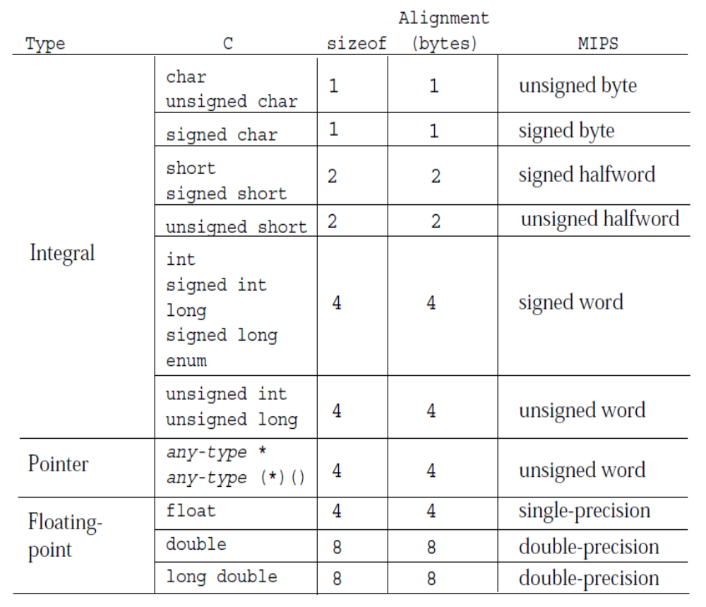
C数据类型与MIPS的对应关系

Slide 35
结构与联合的大小与对齐
An entire structure or union object is aligned on the same boundary as its most strictly aligned member
Each member is assigned to the lowest available offset with the appropriate alignment. This may require internal padding, depending on the previous member
If necessary, a structure’s size is increased to make it a multiple of the alignment. This may require tail padding, depending on the last member

Slide 36
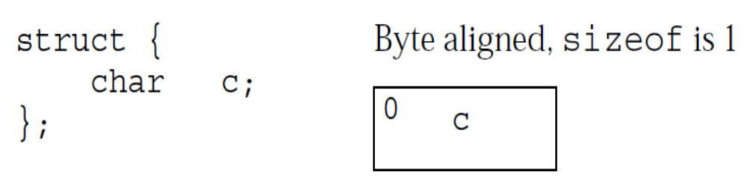
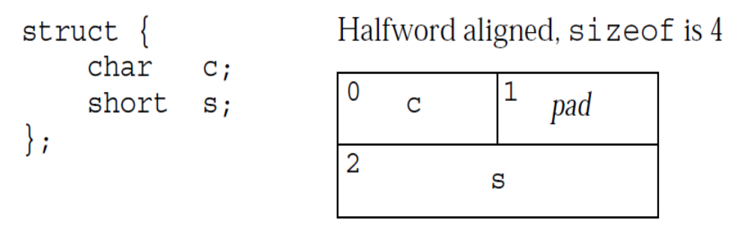
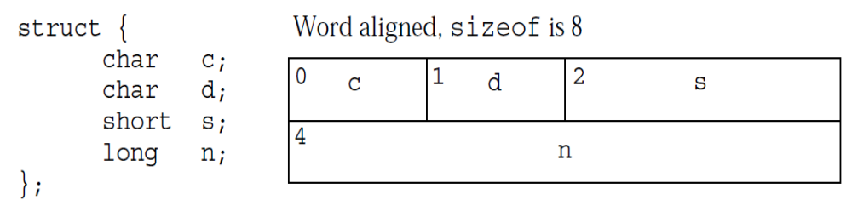

Slide 37
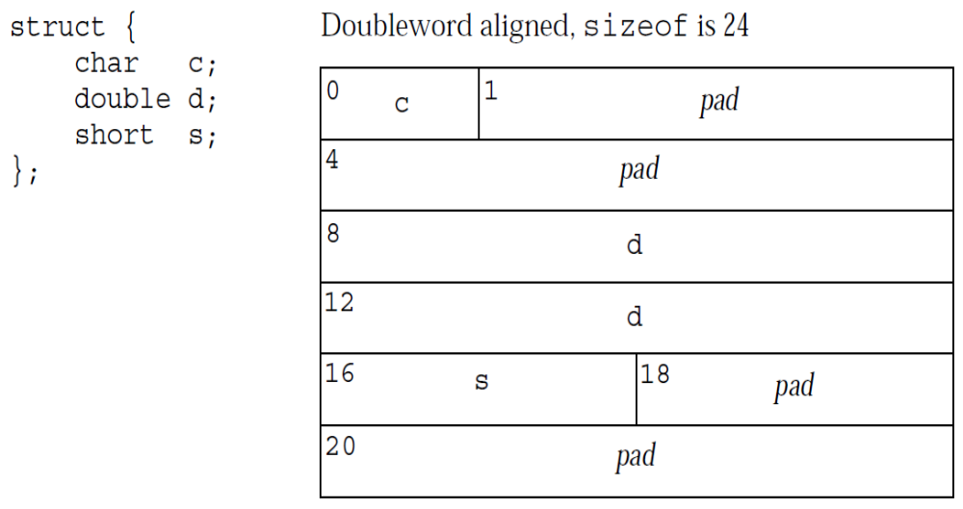
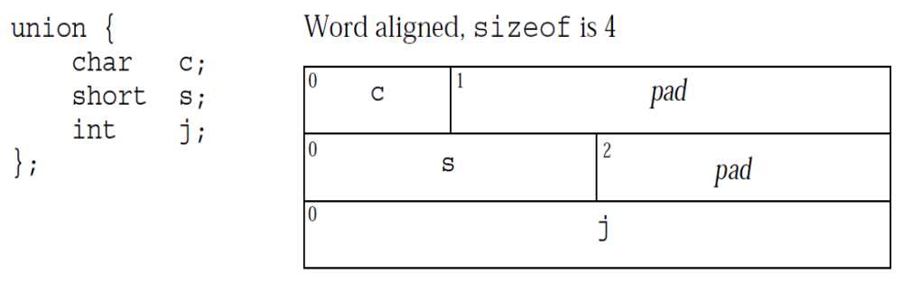

Slide 38
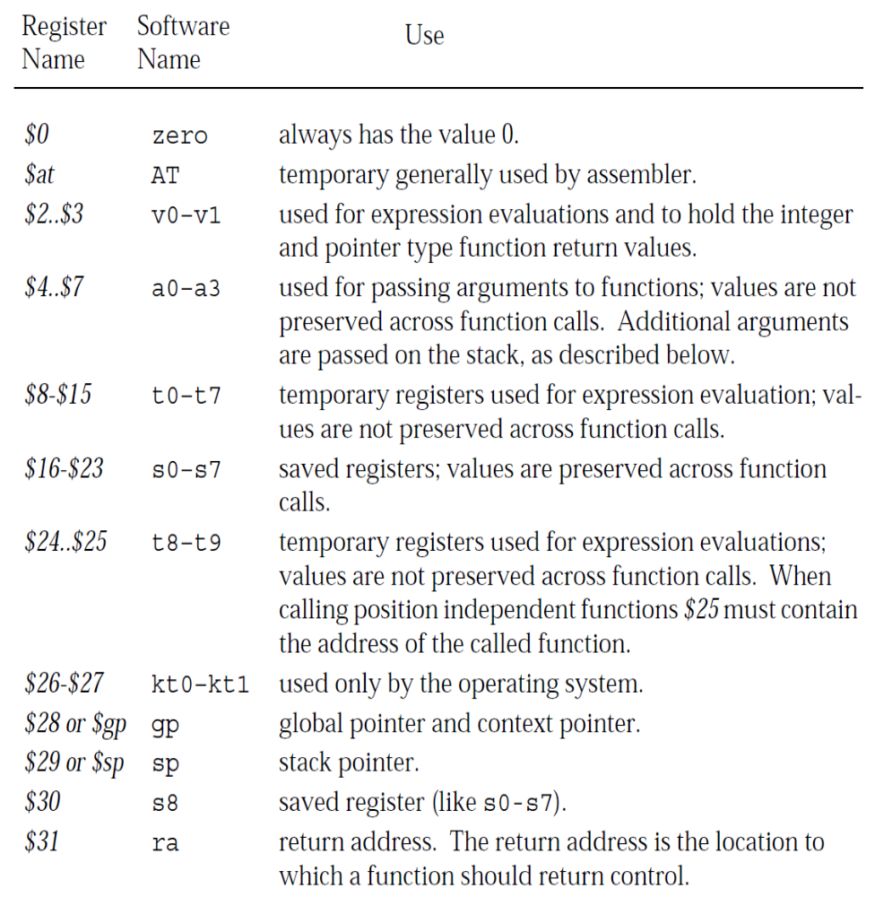
通用寄存器使用约定

Slide 39
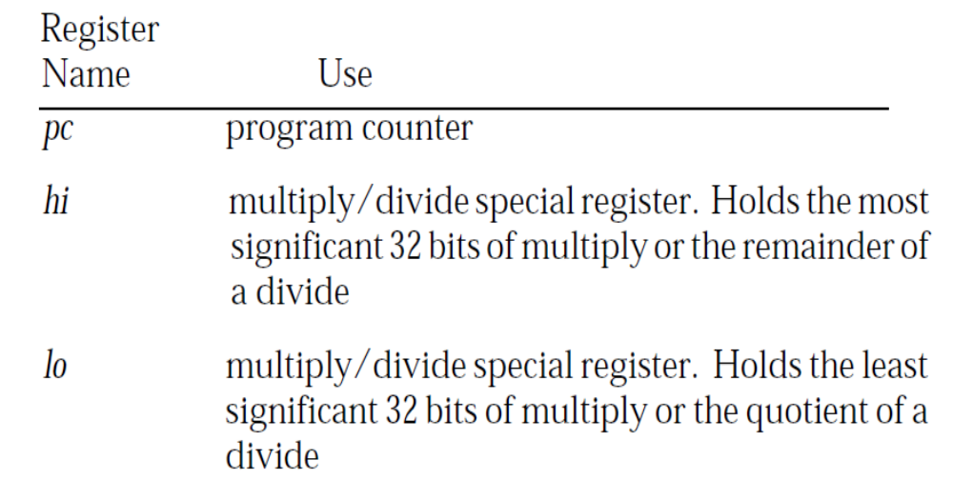
Special CPU registers

Slide 40
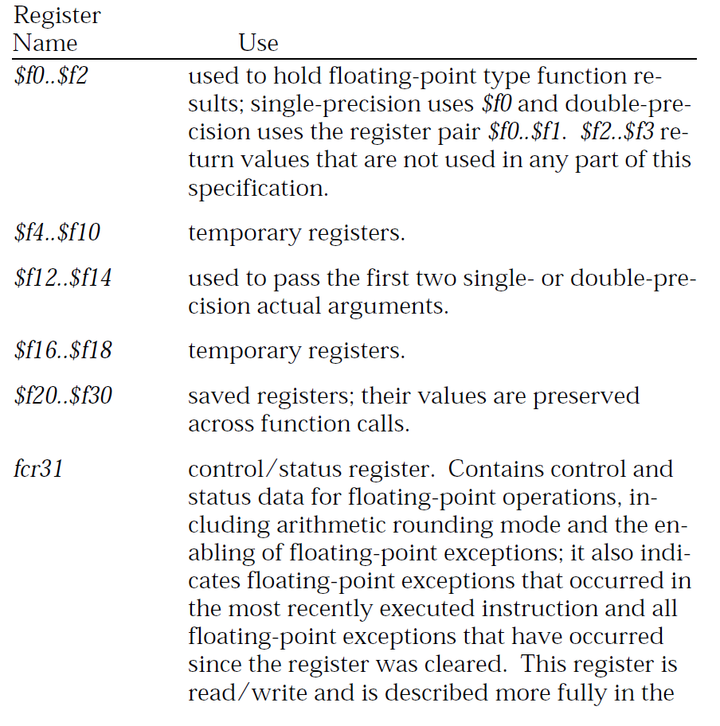
浮点寄存器使用约定

Slide 41
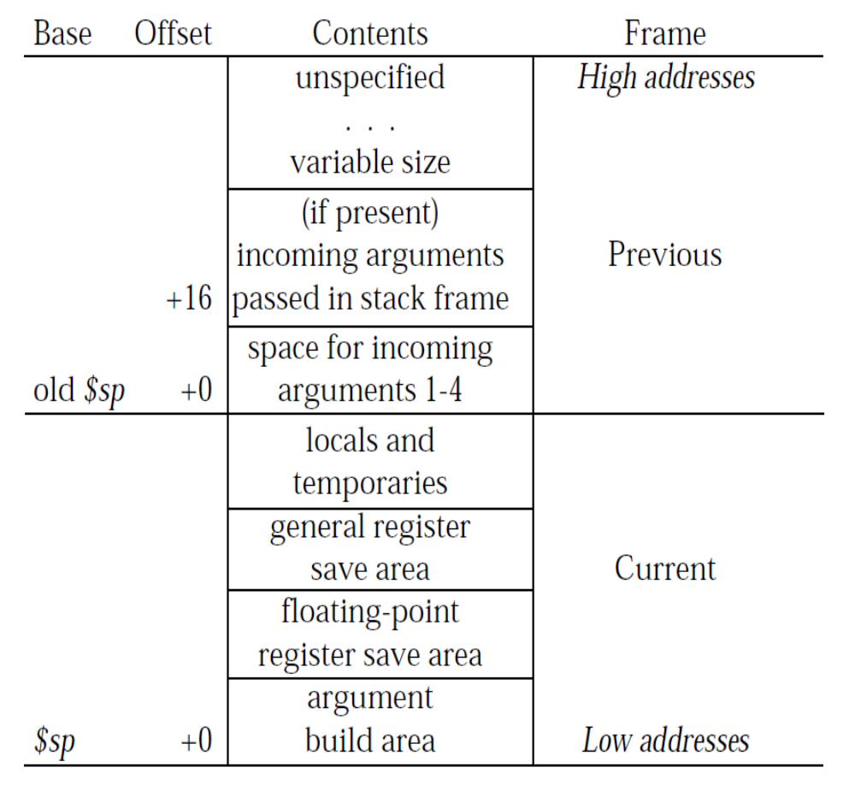
Stack Frame
必须保留
$16-$23、$29-$31
saved in numerical order，from high to low
$f20..$f30

Slide 42
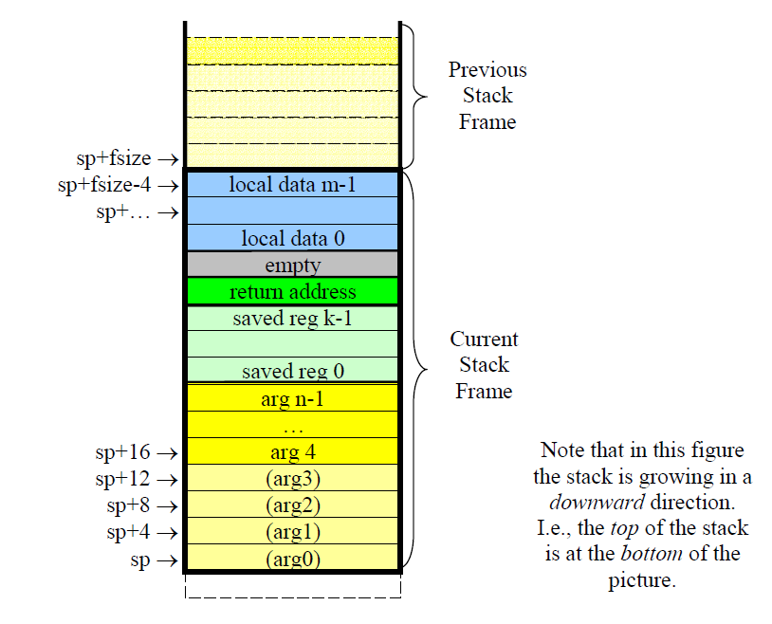
Stack frame

Slide 43
Stack Frame
alignment. Although the architecture requires only word alignment, software convention and the operating system require every stack frame to be doubleword (8 byte) aligned
A function allocates a stack frame by subtracting the size of the stack frame from $sp on entry to the function. This $sp adjustment must occur before $sp is used within the function and prior to any jump or branch instructions

Slide 44
参数传递
Arguments are passed to a function in a combination of integer general registers,floating-point registers, and the stack.
The number of arguments, their type, and their relative position in the argument list of the calling function determines the
mix of registers and memory used to pass arguments.
General registers $4..$7 and floating-point registers $f12 and $f14 pass the first few arguments in registers.
Double-precision floating-point arguments are passed in the register pairs $f12,$f13 and $f14, $f15; single-precision floating-point arguments are passed in registers$f12 and $f14.

Slide 45
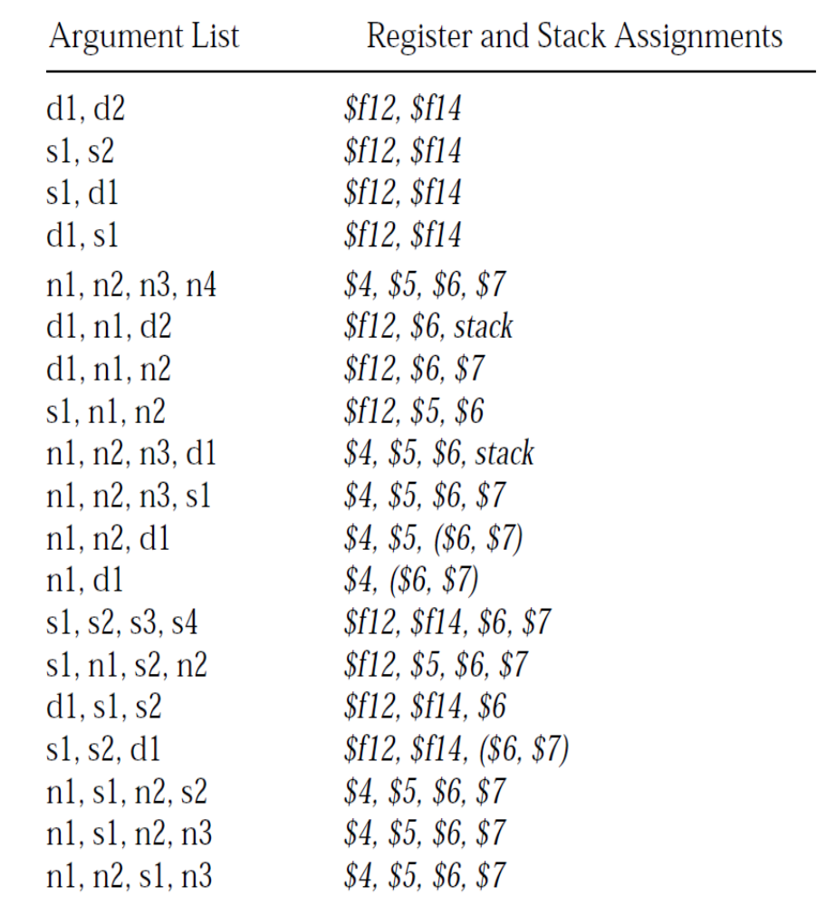
参数传递

Slide 46
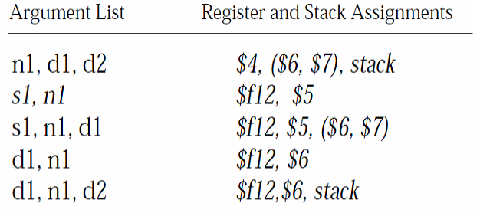
参数传递

Slide 47
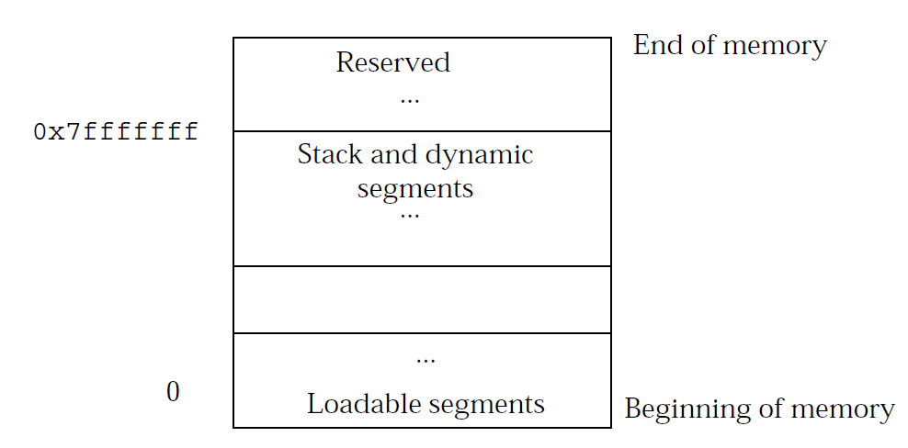
进程地址空间

Slide 48
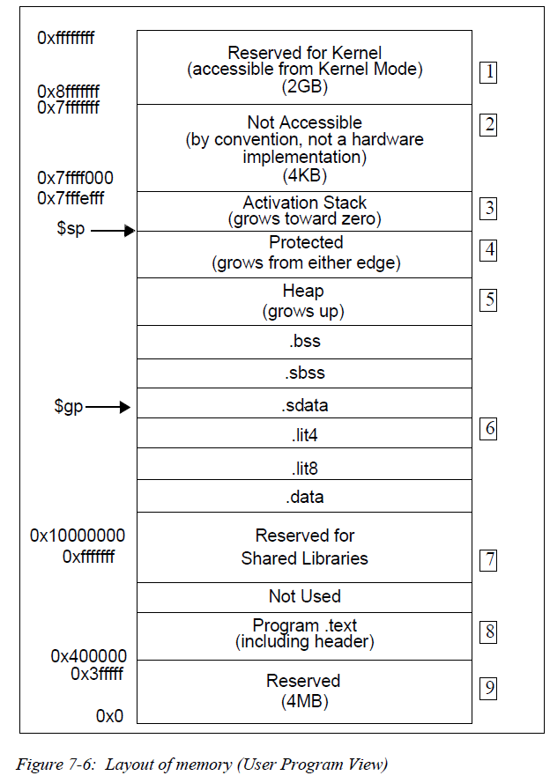
进程地址空间
代码段.text从0x400000开始
0xfffffff到0x10000000保留给共享库使用
数据段.data在共享库（0x10000000）上方
全局指针$gp指向.sdata等
栈从0x7ffff000往下增长
堆在.bss段上部，并往上增长
高2GB，从0x8fffffff开始，保留给kernel使用

Slide 49
第九讲 MIPS汇编（二）
一、MIPS汇编交叉编译调试
二、浮点指令
三、MIPS O32 ABI简介
四、C程序对照

Slide 50
C程序->汇编程序
mipsel-linux-gnu-gcc -S -mips1
mipsel-linux-gnu-gcc -O2 -S -mips1

Slide 51
基本指令
ex:
addiu $sp,$sp,-24
sw $fp,20($sp)
move $fp,$sp
move $2,$4
sw $5,28($fp)
sb $2,24($fp)
lb $3,24($fp)
lw $2,28($fp)
nop
addu $2,$3,$2
sw $2,8($fp)
lw $3,8($fp)
lw $2,28($fp)
nop
xor $3,$3,$2
lw $2,28($fp)
nop
nor $2,$0,$2
or $2,$3,$2
sw $2,12($fp)
lw $2,12($fp)
nop
subu $2,$0,$2
move $sp,$fp
lw $fp,20($sp)
addiu $sp,$sp,24
jr $31
nop
int ex(char a, int b)
{
int x;
int y;
x = (int) a + b;
y = x ^ b | ~b;
return (-y);
}
-S -mips1

Slide 52
基本指令
addiu $sp,$sp,-24
sw $fp,20($sp)
move $fp,$sp
move $2,$4
sw $5,28($fp)
sb $2,24($fp)
lb $3,24($fp)
lw $2,28($fp)
addu $2,$3,$2
sw $2,8($fp)
lw $3,8($fp)
lw $2,28($fp)
xor $3,$3,$2
lw $2,28($fp)
nor $2,$0,$2
or $2,$3,$2
sw $2,12($fp)
lw $2,12($fp)
subu $2,$0,$2
move $sp,$fp
lw $fp,20($sp)
addiu $sp,$sp,24
jr $31
nop
int ex(char a, int b)
{
int x;
int y;
x = (int) a + b;
y = x ^ b | ~b;
return (-y);
}
-S

Slide 53
基本指令
int ex(char a, int b)
{
int x;
int y;
x = (int) a + b;
y = x ^ b | ~b;
return (-y);
}
.type ex, @function
ex:
sll $4,$4,24
sra $4,$4,24
addu $4,$4,$5
xor $4,$4,$5
nor $5,$0,$5
or $2,$4,$5
jr $31
subu $2,$0,$2
-S -O2 -mips1

Slide 54
If - else
.type if_else, @function
if_else:
slt $2,$5,$4
bne $2,$0,$L5
nop
jr $31
subu $2,$5,$4
$L5:
jr $31
subu $2,$4,$5
int if_else(int x, int y)
{
if(x > y)
return (x-y);
else return (y-x);
}
-O2 -S -mips1

Slide 55
switch
int switch_case(int x, int y)
{
int result;
switch(x)
{
case 0: result = y+1;
break;
case 1: result = y+2;
break;
case 2: result = y+4;
break;
default: result = y+y;
break;
}
return result;
}

Slide 56
int switch_case(int x, int y)
{
int result;
switch(x)
{
case 0: result = y+1; break;
case 1: result = y+2; break;
case 2: result = y+4; break;
default: result = y+y; break;
}
return result;
}
swtich_case:
li $2,1 # 0x1
beq $4,$2,$L3
nop
li $2,2 # 0x2
beq $4,$2,$L4
nop
beq $4,$0,$L9
nop
jr $31
sll $2,$5,1
$L9:
jr $31
addiu $2,$5,1
$L4:
jr $31
addiu $2,$5,4
$L3:
jr $31
addiu $2,$5,2
case 1
case 2
case 0
default
-O2 -S -mips1

Slide 57
较大规模的switch-case结构采用跳转表
int switch_case(int x, int y)
{
int result;
switch(x)
{
case 0: result = y+1;
break;
case 1: result = y+2;
break;
case 2: result = y+4;
break;
case 3: result = y+8;
break;
case 4: result = y+16;
break;
default: result = y+y;
}
return result;
}

Slide 58
int switch_case(int x, int y)
{
int result;
switch(x)
{
case 0: result = y+1;
break;
case 1: result = y+2;
break;
case 2: result = y+4;
break;
case 3: result = y+8;
break;
case 4: result = y+16;
break;
default: result = y+y;
}
return result;
}
swtich_case:
.cpload $25
sltu $2,$4,5
beq $2,$0,$L2
sll $4,$4,2
lw $3,%got($L4)($28)
nop
addiu $3,$3,%lo($L4)
addu $4,$3,$4
lw $2,0($4)
nop
addu $2,$2,$28
jr $2
nop
.rdata
.align 2
$L4:
.gpword $L3
.gpword $L5
.gpword $L6
.gpword $L7
.gpword $L8
.text
$L7:
jr $31
addiu $2,$5,8
$L8:
jr $31
addiu $2,$5,16
$L3:
jr $31
addiu $2,$5,1
$L5:
jr $31
addiu $2,$5,2
$L6:
jr $31
addiu $2,$5,4
$L2:
jr $31
sll $2,$5,1
-O2 -S -mips1

Slide 59
swtich_case:
.cpload $25
sltu $2,$4,5
beq $2,$0,$L2
sll $4,$4,2
lw $3,%got($L4)($28)
nop
addiu $3,$3,%lo($L4)
mipsel-linux-gnu-gcc -O2 -c -mips1-o switch2.o switch2.c
mipsel-linux-gnu-objdump -d -r switch2.o
00000000 <swtich_case>:
0: 3c1c0000 lui gp,0x0
0: R_MIPS_HI16 _gp_disp
4: 279c0000 addiu gp,gp,0
4: R_MIPS_LO16 _gp_disp
8: 0399e021 addu gp,gp,t9
c: 2c820005 sltiu v0,a0,5
10: 10400014 beqz v0,64 <swtich_case+0x64>
14: 00042080 sll a0,a0,0x2
18: 8f830000 lw v1,0(gp)
18: R_MIPS_GOT16 .rodata
1c: 00000000 nop
20: 24630000 addiu v1,v1,0
20: R_MIPS_LO16 .rodata
...

Slide 60
for
for_loop:
blez $4,$L8
move $2,$0
move $3,$0
addu $2,$2,$3
$L7:
addiu $3,$3,1
bne $3,$4,$L7
addu $2,$2,$3
jr $31
subu $2,$2,$3
$L8:
jr $31
nop
int for_loop(int n)
{
int i;
int sum = 0;
for(i = 0; i< n; i++)
sum+=i;
return sum;
}
gcc -S

Slide 61
while
while_loop:
blez $4,$L8
move $2,$0
addu $2,$2,$4
$L7:
addiu $4,$4,-1
bne $4,$0,$L7
addu $2,$2,$4
jr $31
subu $2,$2,$4
$L8:
jr $31
nop
int while_loop(int n)
{
int sum = 0;
while(n > 0 )
{
sum+=n;
n--;
}
return sum;
}
gcc -S

Slide 62
do while
do_while_loop:
beq $4,$0,$L8
move $2,$0
addu $2,$2,$4
$L7:
addiu $4,$4,-1
bne $4,$0,$L7
addu $2,$2,$4
jr $31
subu $2,$2,$4
$L8:
jr $31
nop
unsigned int do_while_loop(unsigned int n)
{
unsigned int sum = 0;
if(n <= 0) return 0;
do
{
sum+=n;
n--;
}while(n > 0);
return sum;
}
gcc -S

Slide 63
Hello.c->Hello.s
.globl main
.set nomips16
.set nomicromips
.ent main
.type main, @function
main:
.frame $sp,32,$31 # vars= 0, regs= 1/0, args= 16, gp= 8
.mask 0x80000000,-4
.fmask 0x00000000,0
.set noreorder
.set nomacro
lui $28,%hi(__gnu_local_gp)
lui $4,%hi($LC0)
addiu $28,$28,%lo(__gnu_local_gp)
addiu $sp,$sp,-32
lw $25,%call16(puts)($28)
sw $31,28($sp)
.cprestore 16
.reloc 1f,R_MIPS_JALR,puts
1: jalr $25
addiu $4,$4,%lo($LC0)
move $2,$0
lw $31,28($sp)
nop
j $31
addiu $sp,$sp,32
.set macro
.set reorder
.end main
.size main, .-main

Slide 64
004005c0 <main>:
4005c0: 3c1c0042 lui gp,0x42
4005c4: 3c040040 lui a0,0x40
4005c8: 279c9010 addiu gp,gp,-28656
4005cc: 27bdffe0 addiu sp,sp,-32
4005d0: 8f99804c lw t9,-32692(gp)
4005d4: afbf001c sw ra,28(sp)
4005d8: afbc0010 sw gp,16(sp)
4005dc: 0320f809 jalr t9
4005e0: 24840978 addiu a0,a0,2424
4005e4: 00001025 move v0,zero
4005e8: 8fbf001c lw ra,28(sp)
4005ec: 00000000 nop
4005f0: 03e00008 jr ra
4005f4: 27bd0020 addiu sp,sp,32

